Slide 1
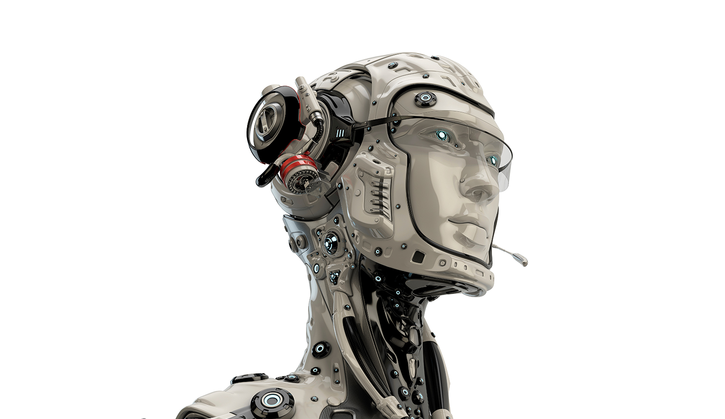

Slide 2
PREDICATE LOGIC
Gidc Degree Engg. College, Abrama
ARTIFICIAL INTELLIGENCE
CODE: 2180703

Slide 3
Coverage
Approaches in Knowledge Representation
Issues in Knowledge Representation,
KR Schemes,
Monotonic
Predicate Logic,
Inheritance,
Frames
Resolution
Natural Deduction
Non-Monotonic
Semantic Nets,
Scripts,

Slide 4
Definitions
Representation – a set of syntactic and semantic conventions that make it possible to describe things.
Syntax – specifies the symbols that may be used and the ways those symbols may be arranged.
Semantics – specifies how meaning is embodied in the symbol arrangements allowed by the syntax.

Slide 5
What is the study of logic?
Logic is the study of making inferences – given a set of facts, we attempt to reach a true conclusion.
An example of informal logic is a courtroom setting where lawyers make a series of inferences hoping to convince a jury / judge .
Formal logic (symbolic logic) is a more rigorous approach to proving a conclusion to be true / false.

Slide 6
Productions
A number of knowledge-representation techniques have been devised:
      Rules
      Semantic nets
      Frames
      Scripts
      Logic
      Conceptual Dependency
      Fuzzy logic

Slide 7
Propositional logic

Slide 8
Representing Simple Facts
Using propositional logic
It is raining
RAINING
It is sunny
SUNNY
It is windy
WINDY
If it is raining, then it is not sunny
RAINING → ¬SUNNY

Slide 9
Representing Simple Facts
Using propositional logic
  Theorem proving is decidable
  Cannot represent objects and quantification
  Propositional calculus is built out of simple statements called propositions which are either true or false.
  Example: “London is a city” is a proposition. So is “Ice is hot”.

Slide 10
Predicate logic

Slide 11
Representing Simple Facts
Using predicate logic
  Can represent objects and quantification
  Theorem proving is semi-decidable

Slide 12
Representing Simple Facts
Example:
All men are mortal.
Socrates is a man.
··· Socrates is mortal.
Note: We need logic laws that work for statements involving quantities
like “some” and “all”.
In English, the predicate is the part of the sentence that tells you something about the subject.

Slide 13
Predicate logic
Definition: A predicate is a property that a variable or a finite collection of variables can have. A predicate becomes a proposition when specific values are assigned to the variables.
P(x1, x2, ..., xn) is called a predicate of n variables or n arguments.
Example:
She lives in the city.
P(x,y): x lives in y.
P(Mary, Austin) is a proposition: Mary lives in Austin.

Slide 14
The Universal Quantifier: ∀
Definition: The symbol ∀ is called the universal quantifier. The universal quantification of P(x) is the statement “P(x) for all values x in the universe”, which is written in logical notation as:
∀x P(x) or sometimes ∀x ∈ D, P(x).
Ways to read ∀x P(x):
For every x, P(x)
For every x, P(x) is true
For all x, P(x)

Slide 15
The Existential Quantifier: ∃
Definition: The symbol ∃ is call the existential quantifier and represents the phrase “there exists” or “for some”.
The existential quantification of P(x) is the statement “P(x) for some values x in the universe”, or equivalently, “There exists a value for x such that P(x) is true”, which is written ∃xP(x).

Slide 16
Representing Simple Facts
Marcus was a man.
2. Marcus was a Pompeian.
3. All Pompeians were Romans.
4. Caesar was a ruler.
All Pompeians were either loyal to Caesar or hated him.
6. Every one is loyal to someone.
People only try to assassinate rulers they are not loyal to.
Marcus tried to assassinate Caesar.

Slide 17
Representing Simple Facts
Marcus was a man.
man(Marcus)

Slide 18
Representing Simple Facts
2. Marcus was a Pompeian.
Pompeian(Marcus)

Slide 19
Representing Simple Facts
3. All Pompeians were Romans.
∀x: Pompeian(x) → Roman(x)

Slide 20
Representing Simple Facts
4. Caesar was a ruler.
ruler(Caesar)

Slide 21
Representing Simple Facts
All Pompeians were either loyal to Caesar or hated him.
inclusive-or
∀x: Roman(x) → loyalto(x, Caesar) ∨ hate(x, Caesar)
exclusive-or
∀x: Roman(x) → (loyalto(x, Caesar) ∧ hate(x, Caesar)) ∨
¬(loyalto(x, Caesar) ∧ hate(x, Caesar))

Slide 22
Representing Simple Facts
6. Every one is loyal to someone.
∀x: ∃y: loyalto(x, y) ∃y: ∀x: loyalto(x, y)

Slide 23
Representing Simple Facts
People only try to assassinate rulers they are not loyal to.
∀x: ∀y: person(x) ∧ ruler(y) ∧ tryassassinate(x, y)
→ ¬loyalto(x, y)

Slide 24
Representing Simple Facts
Marcus tried to assassinate Caesar.
tryassassinate(Marcus, Caesar)

Slide 25
Representing Simple Facts
Was Marcus loyal to Caesar?
man(Marcus)
ruler(Caesar)
tryassassinate(Marcus, Caesar)
⇓ ∀x: man(x) → person(x)
¬loyalto(Marcus, Caesar)

Slide 26
Representing Simple Facts
Many English sentences are ambiguous.
There is often a choice of how to represent knowledge.
Obvious information may be necessary for reasoning
We may not know in advance which statements to deduce (P or ¬P).

Slide 27
Representing Instance & Isa Relationships
Pompeian(Marcus)
∀x: Pompeian(x) → Roman(x)

Slide 28
Representing Instance & Isa Relationships
Pompeian(Marcus)
∀x: Pompeian(x) → Roman(x)
instance(Marcus, Pompeian)
∀x: instance(x, Pompeian) → instance(x, Roman)

Slide 29
Representing Instance & Isa Relationships
Pompeian(Marcus)
∀x: Pompeian(x) → Roman(x)
instance(Marcus, Pompeian)
∀x: instance(x, Pompeian) → instance(x, Roman)
instance(Marcus, Pompeian)
isa(Pompeian, Roman)
∀x: ∀y: ∀z: instance(x, y) ∧ isa(y, z) → instance(x, z)

Slide 30
Computable functions and predicates
Computable predicates
greater-than(1, 0) less-than(0, 1)
greater-than(2, 1) less-than(1, 2)
greater-than(3, 2) less-than(2, 3)
…. ….

Slide 31
Computable functions and predicates
Computable functions
greater-than(2 + 3, 1)

Slide 32
Computable functions and predicates
1. Marcus was a Pompeian.
2. All Pompeians died when the volcano erupted in 79 A.D.
3. It is now 2004 A.D.
Is Marcus alive?

Slide 33
Computable functions and predicates
Marcus was a Pompeian.
Pompeian(Marcus)
All Pompeians died when the volcano erupted in 79 A.D.
erupted(volcano, 79) ∧ ∀x: Pompeian(x) → died(x, 79)
3. It is now 2004 A.D.
now = 2004

Slide 34
Computable functions and predicates
Marcus was a Pompeian.
Pompeian(Marcus)
All Pompeians died when the volcano erupted in 79 A.D.
erupted(volcano, 79) ∧ ∀x: Pompeian(x) → died(x, 79)
3. It is now 2004 A.D.
now = 2004
∀x: ∀t₁: ∀t₂: died(x, t₁) ∧ greater-than(t₂, t₁) → dead(x, t₂)

Slide 35
Resolution
The basic ideas
KB |= α ⇔ KB ∧ ¬α |= false

Slide 36
Resolution
The basic ideas
KB |= α ⇔ KB ∧ ¬α |= false
(α ∨ ¬β) ∧ ( γ ∨ β) ⇒ (α ∨ γ)

Slide 37
Resolution
The basic ideas
KB |= α ⇔ KB ∧ ¬α |= false
(α ∨ ¬β) ∧ ( γ ∨ β) ⇒ (α ∨ γ)
sound and complete

Slide 38
Resolution in Propositional Logic
1. Convert all the propositions of KB to clause form (S).
2. Negate α and convert it to clause form. Add it to S.
Repeat until either a contradiction is found or no progress can be made.
  Select two clauses (α ∨ ¬P) and ( γ ∨ P).
  Add the resolvent (α ∨ γ) to S.

Slide 39
Resolution in Propositional Logic
Example:
KB = {P, (P ∧ Q) → R, (S ∨ T) → Q, T}
α = R

Slide 40
Resolution in Predicate Logic
Example:
KB = {P(a), ∀x: (P(x) ∧ Q(x)) → R(x), ∀y: (S(y) ∨ T(y)) → Q(y), T(a)}
α = R(a)

Slide 41
Resolution in Predicate Logic
Unification:
UNIFY(p, q) = unifier θ where SUBST(θ, p) = SUBST(θ, q)

Slide 42
Resolution in Predicate Logic
Unification:
∀x: knows(John, x) → hates(John, x)
knows(John, Jane)
∀y: knows(y, Leonid)
∀y: knows(y, mother(y))
∀x: knows(x, Elizabeth)
UNIFY(knows(John, x), knows(John, Jane)) = {Jane/x}
UNIFY(knows(John, x), knows(y, Leonid)) = {Leonid/x, John/y}
UNIFY(knows(John, x), knows(y, mother(y))) = {John/y, mother(John)/x}
UNIFY(knows(John, x), knows(x, Elizabeth)) = FAIL

Slide 43
Resolution in Predicate Logic
Unification: Standardization
  UNIFY(knows(John, x), knows(y, Elizabeth)) = {John/y, Elizabeth/x}

Slide 44
Resolution in Predicate Logic
Unification: Most general unifier
  UNIFY(knows(John, x), knows(y, z)) = {John/y, John/x, John/z}
  = {John/y, Jane/x, Jane/z}
  = {John/y, v/x, v/z}
  = {John/y, z/x, Jane/v}
  = {John/y, z/x}

Slide 45
Resolution in Predicate Logic
Unification: Occur check
  UNIFY(knows(x, x), knows(y, mother(y))) = FAIL

Slide 46
Conversion to Clause Form
Eliminate →.
P → Q ≡ ¬P ∨ Q
Reduce the scope of each ¬ to a single term.
  ¬(P ∨ Q) ≡ ¬P ∧ ¬Q
  ¬(P ∧ Q) ≡ ¬P ∨ ¬Q
  ¬∀x: P ≡ ∃x: ¬P
  ¬∃x: p ≡ ∀x: ¬P
  ¬¬ P ≡ P
Standardize variables so that each quantifier binds a unique variable.
  (∀x: P(x)) ∨ (∃x: Q(x)) ≡ (∀x: P(x)) ∨ (∃y: Q(y))

Slide 47
Conversion to Clause Form
Move all quantifiers to the left without changing their relative order.
  (∀x: P(x)) ∨ (∃y: Q(y)) ≡ ∀x: ∃y: (P(x) ∨ (Q(y))
Eliminate ∃ (Skolemization).
  ∃x: P(x) ≡ P(c) Skolem constant
  ∀x: ∃y P(x, y) ≡ ∀x: P(x, f(x)) Skolem function
Drop ∀.
  ∀x: P(x) ≡ P(x)
Convert the formula into a conjunction of disjuncts.
(P ∧ Q) ∨ R ≡ (P ∨ R) ∧ (Q ∨ R)
8. Create a separate clause corresponding to each conjunct.
9. Standardize apart the variables in the set of obtained clauses.

Slide 48
Conversion to Clause Form
1. Eliminate →.
2. Reduce the scope of each ¬ to a single term.
Standardize variables so that each quantifier binds a unique variable.
Move all quantifiers to the left without changing their relative order.
Eliminate ∃ (Skolemization).
Drop ∀.
Convert the formula into a conjunction of disjuncts.
Create a separate clause corresponding to each conjunct.
Standardize apart the variables in the set of obtained clauses.

Slide 49
Conversion to Clause Form
Example:
All Romans who know Marcus either hate Caesar or think that anyone who hates someone is crazy.
∀x: [Roman(x) ∧ know(x, Marcus)]
→ [hate(x, Caesar) ∨ (∀y: ∀z: hate(y, z) → thinkcrazy(x, y))]

Slide 50
Resolution in Predicate Logic
Marcus was a man.
2. Marcus was a Pompeian.
3. All Pompeians were Romans.
4. Caesar was a ruler.
All Pompeians were either loyal to Caesar or hated him.
6. Every one is loyal to someone.
People only try to assassinate rulers they are not loyal to.
Marcus tried to assassinate Caesar.

Slide 51
Resolution in Predicate Logic
Man(Marcus).
2. Pompeian(Marcus).
3. ∀x: Pompeian(x) → Roman(x).
4. ruler(Caesar).
∀x: Roman(x) → loyalto(x, Caesar) ∨ hate(x, Caesar).
∀x: ∃y: loyalto(x, y).
∀x: ∀y: person(x) ∧ ruler(y) ∧ tryassassinate(x, y)
→ ¬loyalto(x, y).
8. tryassassinate(Marcus, Caesar).

Slide 52
Resolution in Predicate Logic
Prove:
hate(Marcus, Caesar)

Slide 53
Resolution in Predicate Logic
1. Marcus was a Pompeian.
2. All Pompeians died when the volcano erupted in 79 A.D.
3. It is now 2004 A.D.
Prove:
Marcus is not alive.

Slide 54
Resolution in Predicate Logic
Pompeian(Marcus).
erupted(volcano, 79) ∧ ∀x: Pompeian(x) → died(x, 79).
now = 2004.
∀x: ∀t₁: ∀t₂: died(x, t₁) ∧ greater-than(t₂, t₁) → dead(x, t₂)

Slide 55
Question Answering
When did Marcus die?
Whom did Marcus hate?
3. Who tried to assassinate a ruler?
4. What happen in 79 A.D.?.
5. Did Marcus hate everyone?

